Slide 1
Integrated Systems Biology Lab, Department of Systems Science, Graduate School of Informatics, Kyoto University Sep. 2nd, 2013 – IBISML 2013
Enhancing Probabilistic Appearance-Based Object Tracking with Depth Information: Object Tracking under Occlusion
Kourosh MESHGI
Yu-zhe LI
Shigeyuki OBA
Shin-ichi MAEDA
and Prof. Shin ISHII

Slide 2
Outline
Introduction
Literature Review
Proposed Framework
Gridding
Confidence Measure
Occlusion Flag
Experiments
Conclusions

Slide 3
INTRODUCTION & LITERATURE REVIEW

Slide 4
Object Tracking: Applications
Human-Computer Interfaces
Human Behavior Analysis
Video Communication/Compression
Virtual/ Augmented Reality
Surveillance

Slide 5
Object Tracking: Strategies
Bottom-Up
* Blob Detection (not efficient)
Top- Down
* Model-based
* Template Matching
* Particle Filter
* Objects are segmented out from image in each frame which is used for tracking
*Generates hypotheses and aims to verify them using the image

Slide 6
Object Tracking
Discriminative
Generative: Keep the status of each object by a PDF
Particle filtering
Monte Carlo-based methods
Bayesian networks with HMM
Real-time computation
Use compact appearance models e.g. color histograms or color distribution
Trades the number of evaluated solutions
Granularity of each solution

Slide 7
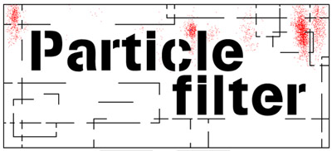
Particle Filters
Idea: Applying a recursive Bayesian filter based on sample set
Applicable to nonlinear and non-Gaussian systems
Computer Vision: Condensation algorithm → developed initially to track objects in cluttered environments
Multiple hypotheses
Short-Term Occlusions
Long-Term Occlusions

Slide 8
Object Tracking: Occlusion
Generative models do not address occlusion explicitly → maintain a large set of hypotheses
Discriminative models → direct occlusion detection
☺robust against partial and temporary occlusions
☹long-lasting occlusions hinder their tracking heavily
Occlusions
Update model for target → Type of Occlusion is Important → Keep memory vs. Keep focus on the target
Dynamic Occlusion: Pixels of other object close to camera
Scene Occlusion: Still objects are closer to camera than the target object
Apparent occlusion: Result of shape change, silhouette motion, shadows, or self-occlusions

Slide 9
Object Tracking: Depth Integration
Usage of depth information only
Use depth information for better foreground segmentation
Statistically estimate 3D object positions

Slide 10
Object Tracking: Challenges
Appearance Changes
Illumination changes
Shadows
Affine transformations
Non-rigid body deformations
Occlusion
Sensor Parameters & Compatibility
Field of view
Position
Resolution
Signal-to-noise ratio
Segmentation Inherent Problems
Partial segmentation
Split and merge
Channels data fusion

Slide 11
PROPOSED FRAMEWORK

Slide 12
Overview
Goals of Tracker
Handles object tracking even under persistent occlusions
Highly adaptive to object scale and trajectory
Perform a color and depth information fusion
Particle Filter
Rectangular bounding boxes as hypotheses of target presence
Described by a color histogram and median of depth
Compared to each bounding box in terms of the Bhattacharyya distance
Regular grids for bounding box
Confidence measure for each cell
Occlusion flag attached to each particle
GOAL
PARTICLE FILTERS

Slide 13
Design: Representation
Center of mass
Silhouette (or blobs)
Bounding boxes
No sufficient information about shape, size and distance
Computational complexity
Simplified version of Silhouettes
Enhanced with Gridding (new)

Slide 14
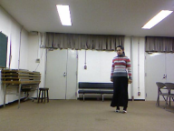
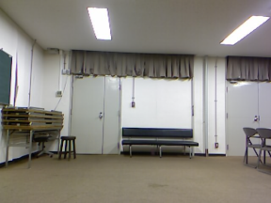
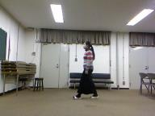
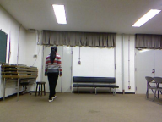
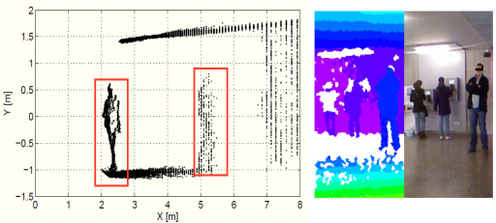
Design: Preprocessing
Foreground-Background Separation: Temporal median bkg
Normalizing Depth using Sensor Characteristics
Relation between raw depth values and metric depth
Sensitivity to IR-absorbing material, especially in long distances
Clipping out-of-range values
Up-sampling to match image size

Slide 15
Design: Notation
Bounding Box
Occlusion Flag
Image Appearance (RGB)
Depth Map
Ratio of Foreground Pixels
Histogram of Colors
Median of Depth
Goal Template
Grid cell i

Slide 16
Observation Model
Each Particle is represented by
A Bounding Box
An Occlusion Flag
Decomposed to Grid Cells
To capture Local Information
Cells are assumed Independent
Template has similar grid

Slide 17
Non-Occlusion Case
Information obtained from two channels
Color Channel (RGB) → Appearance Information
Depth Channel → Depth Map
Channels are assumed Independent
Channels are not always reliable
The problems usually arise from appearance data
Requires a confidence measure → Ratio of pixels containing information to all pixels would help

Slide 18
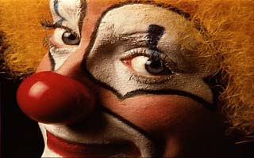
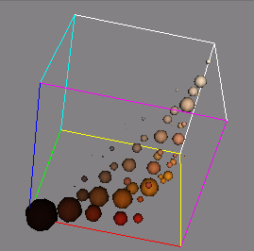
Design: Feature Extraction I Histogram of Colors
Bag-of-words Model
Invariant to rigid-body motions, non-rigid-body deformations, partial occlusion, down sampling and perspective projection
Each scene → Certain volume of color space → Exposed by clustering colors
RGB space + K-means clustering with fixed number of bins

Slide 19
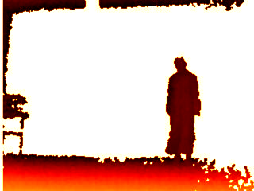
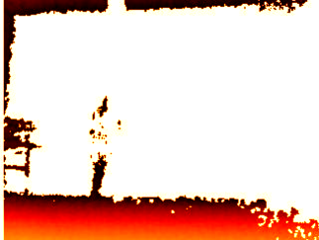
Design: Feature Extraction II Median of Depth
Depth information → Noisy data
Histogram of Depth.
Needs fine-tuned bins → separate foreground and background pixels in clutter
Subjects are usually spans in a short range of depth values
Resulting histograms are too spiky in depth planes that essentially those bins can represent the histogram
Higher level of informative features based on depth value exists e.g. Histogram of Oriented Depths (HOD)
Surplus computational complexity
Special consideration (sensitivity to noise, etc.)
Median of depth!

Slide 20
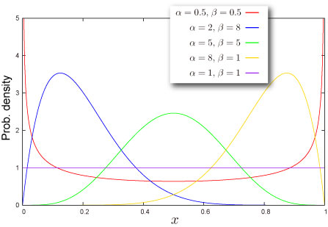
Design: Feature Extraction III Confidence
Depends on amount of pixels containing information in cell
Ratio of foreground pixels to all pixels of each box → Invariant to box size
Moves towards Zero: Box does not contain many foreground pixels → HoC not be statistically significant
Moves towards One: Doesn’t mean that the cell is completely trustable
Whole bounding box size could be very small
Misplaced
Beta distribution over ratio
Fit on training data
Two shape parameters: a and b

Slide 21
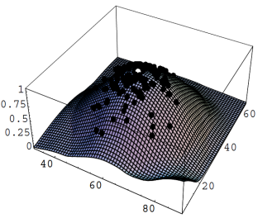
Design: Similarity Measure
Histogram of Colors
Bhattacharyya Distance
KL-Divergance
Euclidean Distance
Median of Depth → Bhattacharya Distance
Log-sum-exp trick

Slide 22
Occlusion Case
Occlusion Flag as a part of Representation
Occlusion Time Likelihood
No big difference between bounding boxes
Uniform Distribution

Slide 23
Particle Filter Update
Occlusion State Transition
a 2×2 matrix
Decides whether newly sampled particle should stay in previous state or change it by a stochastic manner
Along with particle filter resampling and uniform distribution of occlusion case, can handle occlusion stochastically
Particle Resampling
Based on particle probability → Occlusion case vs. Non-Occlusion case
Bounding box position and size are assumed to have no effect on occlusion flag for simplicity.

Slide 24
Target Model
Initialization
Manually
Automatically with known color hist.
Object detection algorithm
Expectation of Target
Statistical expectation of all particles
Target Update
Smooth transition between video frames
By discarding image outlier
Forgetting process
Same for updating depth
Occlusion Handling
Updating a model under partial or full occluded model → losing proper template gradually for next slides

Slide 25
Visualizations

Slide 26
Algorithm
Initialization
Color Clustering
Target Initialization
Preprocessing
Tracking Loop
Input Frame
Update Background
Calculate Bounding Box Features
Calculate Similarity Measures
Estimate Next Target
Resample Particles
Update Target Template

Slide 27
EXPERIMENTS

Slide 28
Criteria
Specially designed metrics to evaluate bounding boxes for multiple objects tracking
Proposed for a classification of events, activities and relationships (CLEAR) project
Multiple object tracker precision (MOTP): ability of the tracker to estimate precise object positions, independent of its skill at recognizing object configurations, keeping consistent trajectories, etc
Multiple object tracker accuracy (MOTA): including number of misses, of false positives, and of mismatches, respectively, for time t.
Scale adaptation
Lower values of SA indicates better adaptation of algorithm to scale.

Slide 29
Experiments
Toy dataset
Acquired with Microsoft Kinect
Image resolution of 640×480 and depth image resolution of 320×240
Annotated with target bounding box coordinates and occlusion status as ground truth
Scenario One
Walking
Mostly in parallel with camera z-plane + parts towards the camera → Test the tracking accuracy and scale adoptability
Appearance of the subject changed drastically in several frames
Rapid changes in direction of movement and velocity
Depth information of those frames remains intact → Test the robustness of algorithm
Scenario Two
Same video
A rectangular space of the data is occluded manually.

Slide 30
Result I
Tracker | MOTP | MOTA | SA
RGB | 87.2 | 97.1% | 112.8
RGB-D | 38.1 | 100% | 99.9
RGB-D Grid 2×2 | 23.6 | 100% | 48.5
RGB-D Grid 2×2+ Occlusion Flag | 24.1 | 100% | 51.2

Slide 31
Result II
Tracker | MOTP | MOTA | SA
RGB | 153.1 | 57.2% | 98.8
RGB-D | 93.2 | 59.1% | 91.9
RGB-D Grid 2×2 | 73.1 | 46.1% | 59.2
RGB-D Grid 2×2+ Occlusion Flag | 53.1 | 83.3% | 67.5

Slide 32
FINALLY…

Slide 33
Conclusion
Hybrid space of color and depth
Resolves loss of track for abrupt appearance changes
Increases the robustness of the method
Utilized the depth information effectively to judge who occludes the others.
Gridding bounding box: Better representation of local statistics of foreground image and occlusion
Improves scale adaptation of the algorithm
Preventing the size of bounding box to bewilder around the optimal value
Occlusion flag: Distinguishing the occluded and un-occluded cases explicitly
Suppressed the template update
Extended the search space under the occlusion
Confidence measure: Evaluates ratio of fore- and background pixels in a box
Giving flexibility to the bounding box size
Search in Scale space as well
Splitting & Merging

Slide 34
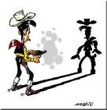
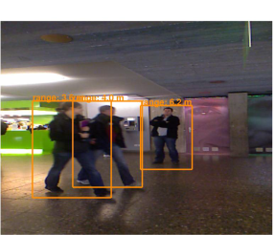
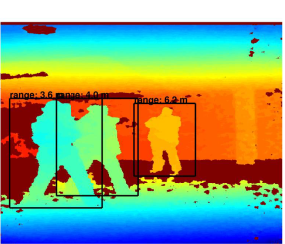
Future Work
Preprocessing: Shadow Removal
Preprocessing: Crawling Background
Design: Better color clustering method to handle crawling background e.g. Growing K-means
Design: No independence between grids
Design: More elaborated State Transition Matrix
Experiment: Using Public datasets (ViSor, PET 2006, etc.)
Experiment: Using Real World Occlusion Scenario

Slide 35
Thank You!

Slide 36
Object Tracking: Input Data
2D: Monocular Cameras
Rely on appearance models
Models have one-to-one correspondence to objects in the image
Suffer from occlusions, fail to handle all object interactions
3D: Stereo Cameras / Multiple Cameras
2.5D: Depth-Augmented Images
Microsoft Kinect
More robust to occlusions
Prone to major tracking issues
Category: Type and configuration of cameras

Slide 37
Object Tracking: Single Object
Plenty of literature, Wealth of tools
Rough Categorization
Tracking separated targets → Popular competition
Multiple object tracking → Challenging task → Dynamic change of object attributes
Model-Based
Appearance-Based
Feature-Based
Color Distribution
Shape
Visibility

Slide 38
Why Bounding Boxes
Bounding box for Tracking
Encapsulates a rectangle of pixels
RGB pixels in color
Normalized depth
Top-left corner and width and height (x,y,w,h)
The size of the bounding box can change during tracking freely
Accommodates scale changes
Handle perspective projection effects
Doesn’t model velocity components explicitly
Trajectory Independence
Handle sudden change in the direction
Large variations in speed

